Slide 1
Diagnosis Prediction Case Study: Predicting ASD & ADHD Risk from the EHR
Matthew Engelhard

Slide 2
Early Autism & ADHD prediction from the EHR
Long-term benefits of early treatment depend on effective early diagnosis
Profound racial, ethnic, and socioeconomic disparities in:
Rates of early diagnosis
Time between problem recognition and diagnosis
Length of follow-up
Autism
ADHD
Cumulative Diagnosis Rate
Age, in Years
Goal: Diagnose autism before age 3
Duke Forge, NICHD 1P50HD093074, NIMH/NINDS 1 R01 MH121329
Notes:
For both autism and ADHD, identifying the condition as early as possible is critically important
Both of these conditions have profound impact on long-term health and well-being
But we know – particularly in autism, and Geri Dawson is a pioneer in this area – but also in ADHD, that initiating treatment early in life – in the case of autism this means early behavioral intervention, in ADHD in means access to appropriate resources, including at school, and including access to medication – we know that early treatment can substantially mitigate many of those negative impacts
But of course, only by diagnosing these conditions promptly can children have access to the care and services they need
Most children are not identified early enough
And furthermore, there are significant disparities in early diagnosis – for example, in time between when someone (parent? Provider?) first notices a problem and when diagnosis occurs
But information collected during routine care, accessible in the EHR, provides substantial information about these early health trajectories, and about subsequent autism and ADHD risk
Our goal is to use this information to stratify risk from an early age – ideally, in the case of autism, children would be diagnosed and receive services before turning 3

Slide 3
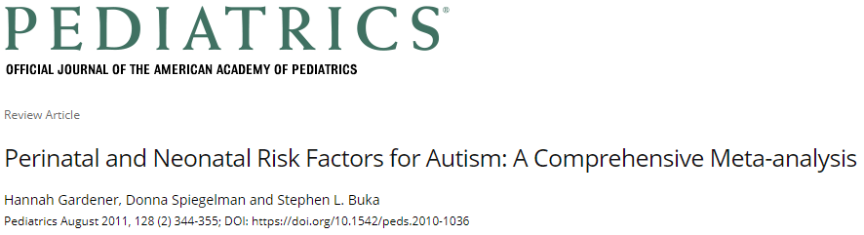
Perinatal and Neonatal Factors (# studies) | Results Across Studies | Summary Effect Estimate (95% CI)
Presentation
Abnormal presentation (15) | 10−, 5↑ | 1.44 (1.07–1.94)
Breech (4) |  | 1.81 (1.21–2.71)
Other perinatal factors
Cord complications (14) | 13−, 1↑ | 1.50 (1.00–2.24)
Fetal distress (4) | 3−, 1↑ | 1.52 (1.09–2.12)
Birth injury or trauma (6) | 6− | 4.90 (1.41–16.94)
Twins or multiple birth (10) | 7−, 3↑ | 1.77 (1.23–2.55)
Maternal hemorrhage (4) | 3−, 1↑ | 2.39 (1.35–4.21)
Birth weight and size
Total birth weight (decreased) (15) | 12−, 2↑, 1↓
Low birth weight (<2500 g) (15) | 8−, 7↑ | 1.63 (1.19–2.33)
Small for gestational age (10) | 7−, 3↑ | 1.35 (1.14–1.61)
Clinical impression
Congenital malformation (11) | 4−, 7↑ | 1.80 (1.42–2.82)
Apgar score
Low 5-minute Apgar score (8) | 6−, 2↑ | 1.67 (1.24–2.26)
Neonatal Status
Feeding difficulties (3) | 2↑, 1− | 3.35 (1.33–8.40)
Meconium aspirated (3) | 2−, 1↑ | 7.34 (2.30–23.47)
Neonatal medical conditions
Anemia (4) | 3−, 1↑ | 7.87 (1.43–43.36)
ABO or Rh incompatible (5) | 4−, 1↑ | 3.70 (1.90–7.23)
Hyperbilirubinemia (6) |  | 1.87 (1.01–3.47)

Slide 4
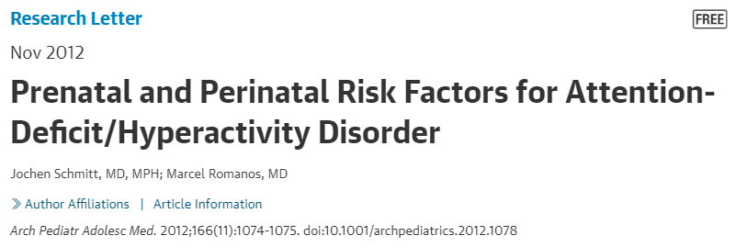
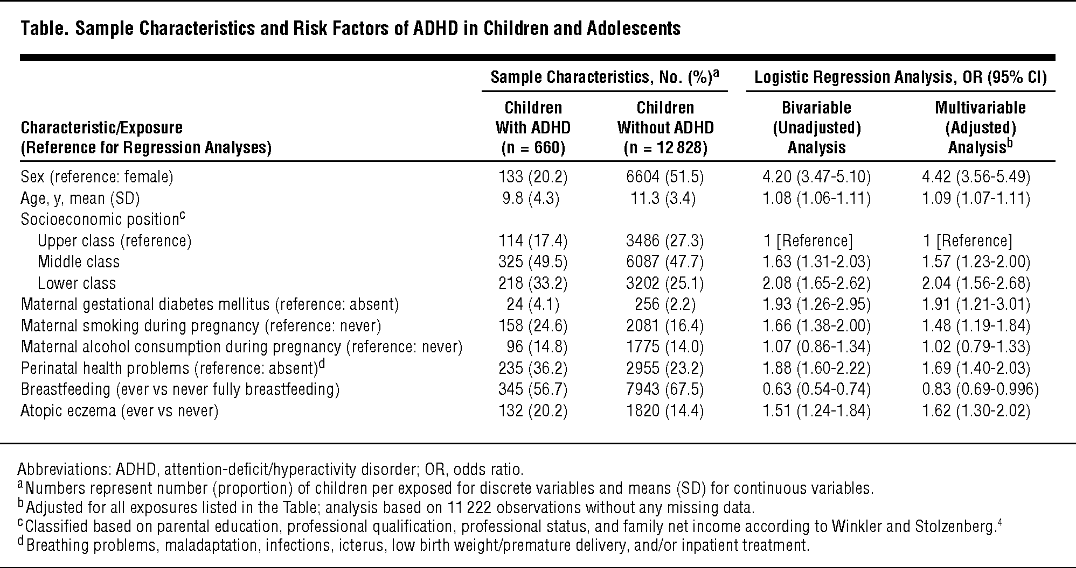

Slide 5
Our Predictive Modeling Journey…
Getting the data & making sense of it (or trying to)
Defining the outcome (i.e. what are we even predicting?)
Structuring the prediction task (i.e. but what are we really predicting?)
Incorporating clinical notes (and all the ways it can go wrong)

Slide 6
1. Get the data and (try to) make sense of it

Slide 8

Where is the data we need?

Slide 9
Where is the data we need?
Length
APGAR Scores
Medications
Fetal distress
Vitals
Head Circumference
Weight
Decelerations
Diagnoses
Gestational age at birth
Breech presentation
Procedures
Labs
Meconium in amniotic fluid
Notes:
And at the same time, we started putting together a wish list of data elements that we believed were important for this problem

Slide 10
Where is the data we need?
Length
APGAR Scores
Medications
Fetal distress
Vitals
Head Circumference
Weight
Decelerations
Diagnoses
Gestational age at birth
Breech presentation
Procedures
Labs
Meconium in amniotic fluid
Notes:
We were happy to see that some of these factors were pretty easy to find
For example, we know neonatal hyperbilirubinemia is associated with autism, and it’s right there in DEDUCE where we expected

Slide 11
Where is the data we need?
Length
APGAR Scores
Medications
Fetal distress
Vitals
Head Circumference
Weight
Decelerations
Diagnoses
Gestational age at birth
Breech presentation
Procedures
Labs
Meconium in amniotic fluid
Notes:
But other critical pieces of data weren’t consistently available, and the closer we looked, the more we realized that they weren’t reliable

Slide 12
Where is the data we need?
Length
APGAR Scores
Medications
Fetal distress
Vitals
Head Circumference
Weight
Decelerations
Diagnoses
Gestational age at birth
Breech presentation
Procedures
Labs
Meconium in amniotic fluid
Notes:
And then, there were elements we wanted that just wasn’t there
We’re confident that these values are collected
But they’re not accessible, because they’re not present in structured fields
(approx. 2 min)

Slide 13
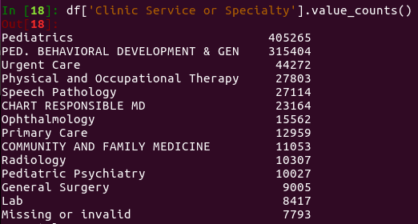
Which values can we trust?
Notes:
As we went along, we first focused on interactions with the health system, which were easy to access
But even these data are deceptively difficult to interpret

Slide 14
Which values can we trust?
Notes:
What looks like a clear distinction between outpatient clinic services – in this case, Pediatrics and developmental-behavioral pediatrics –
Turns out to be a quirk of the data that we now know is misleading and not meaningful

Slide 15
Which values can we trust?
Notes:
On top of that, way too many patients keep visiting services like ‘chart responsible MD’

Slide 16

Defining the Cohort
All patients born between October 6, 2006 and October 1, 2016 with ≥2 well-child visits before age 1
N = 29,929
Notes:
Even the most basic task – defining our cohort – turned out to be challenging
We needed to identify children who got their routine care at Duke in their first year of life
But finding an accessible, reliable criterion for this wasn’t easy
Still, pushing through with our amazing team, we’ve overcome these challenges and begun developing our model
And already we’ve learned something really important that we didn’t know before

Slide 17
Increased Hospital Admissions, Procedures, and ED Visits before age 1
Procedures
Notes:
We knew that individuals already diagnosed with autism and ADHD visited the health system much more often
But now, we also know that increased utilization begins long before diagnosis, in the early days of life
It seems the conditions themselves are associated with increased utilization – it’s not just our recognition and treatment of them that’s responsible.
(approx 3 min)

Slide 18
Distinctive Patterns of Outpatient Specialty Care before age 1
Notes:
On top of the fact that they’re visiting the health system more often
We found that they have distinctive, condition-specific patterns of utilization
Children with autism are more likely to visit ophthalmology, for example

Slide 19
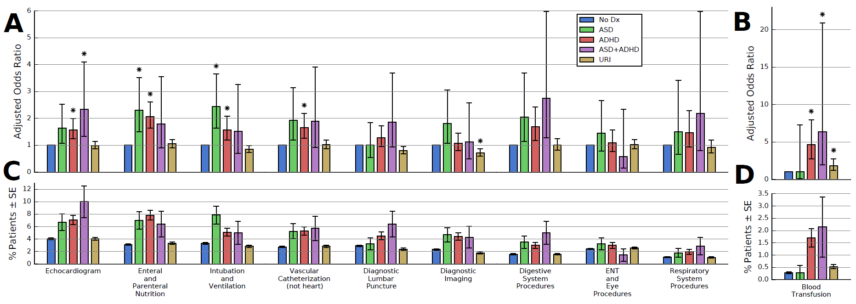
Distinctive Patterns of Procedures before age 1
Notes:
Whereas children with ADHD are more likely to get a blood transfusion in their first year of life
And so, going forward, we’re using machine learning to figure out which findings – or combinations and transformations of findings – have high predictive value

Slide 20
Prediction Model -> Clinically Meaningful Performance Measures
 | Model-based referral | No model-based referral
Child has autism | Earlier Diagnosis (true positive) | Referral via Current Mechanisms (false negative)
Child does not have autism | Unnecessary Specialist Visit (false positive) | No Action Taken or Needed (true negative)
Decision: initiate referral
*model is NOT used to rule out diagnoses*
Measures of Success:
How much earlier, on average, can we diagnose and intervene?
How many children are unnecessarily referred?
Notes:
And once we’ve developed a model that effectively stratifies every child’s neurodevelopmental risk
We hope to implement it in the EHR and actually use it to trigger referral
But if that’s the goal, we need to think carefully about the impact it’ll have on the health system. We could run down the list of machine learning performance metrics
But those aren’t the measures we really care about. What we’d like to know is:
How much earlier, on average, can we diagnose these conditions?
How many children are incorrectly referred as a result?
Importantly, we need to make sure our model is not being used to rule out diagnoses, which could have the unintended effect of delaying intervention for children who need it
It’s been an incredible year, and we’re excited to continue this work with your support
Thank you
(4 min)

Slide 21
2. Figure out what we’re predicting

Slide 22
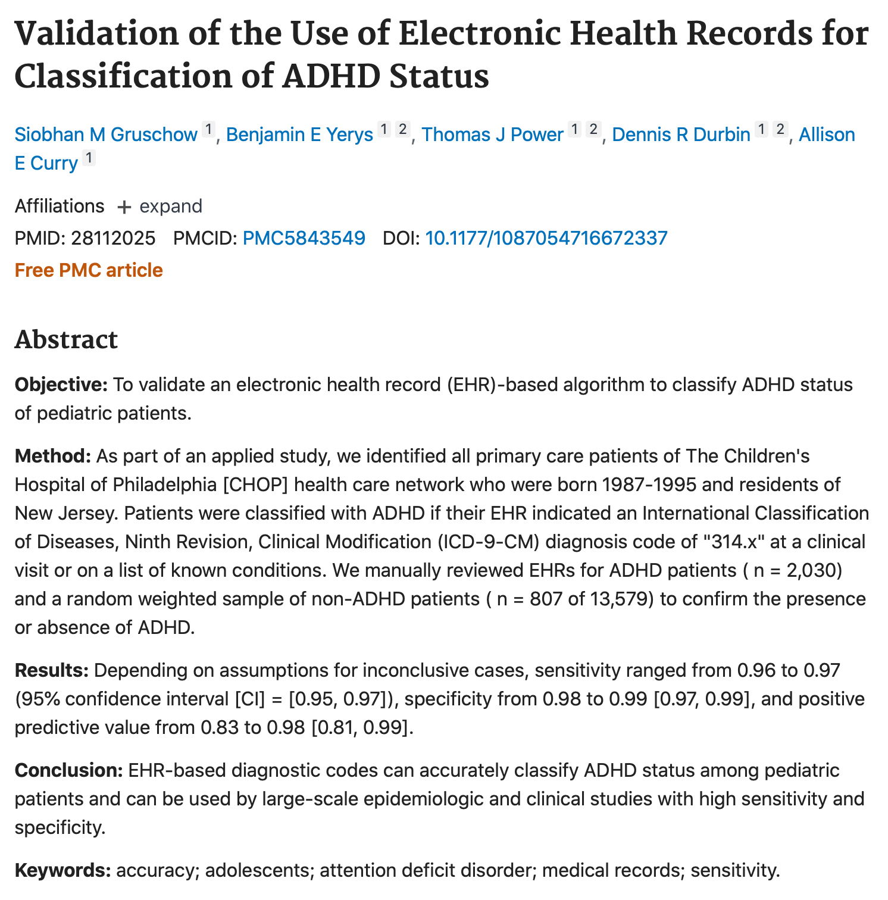
ADHD Computable Phenotype: - 2 codes, or 1 + med

Slide 23
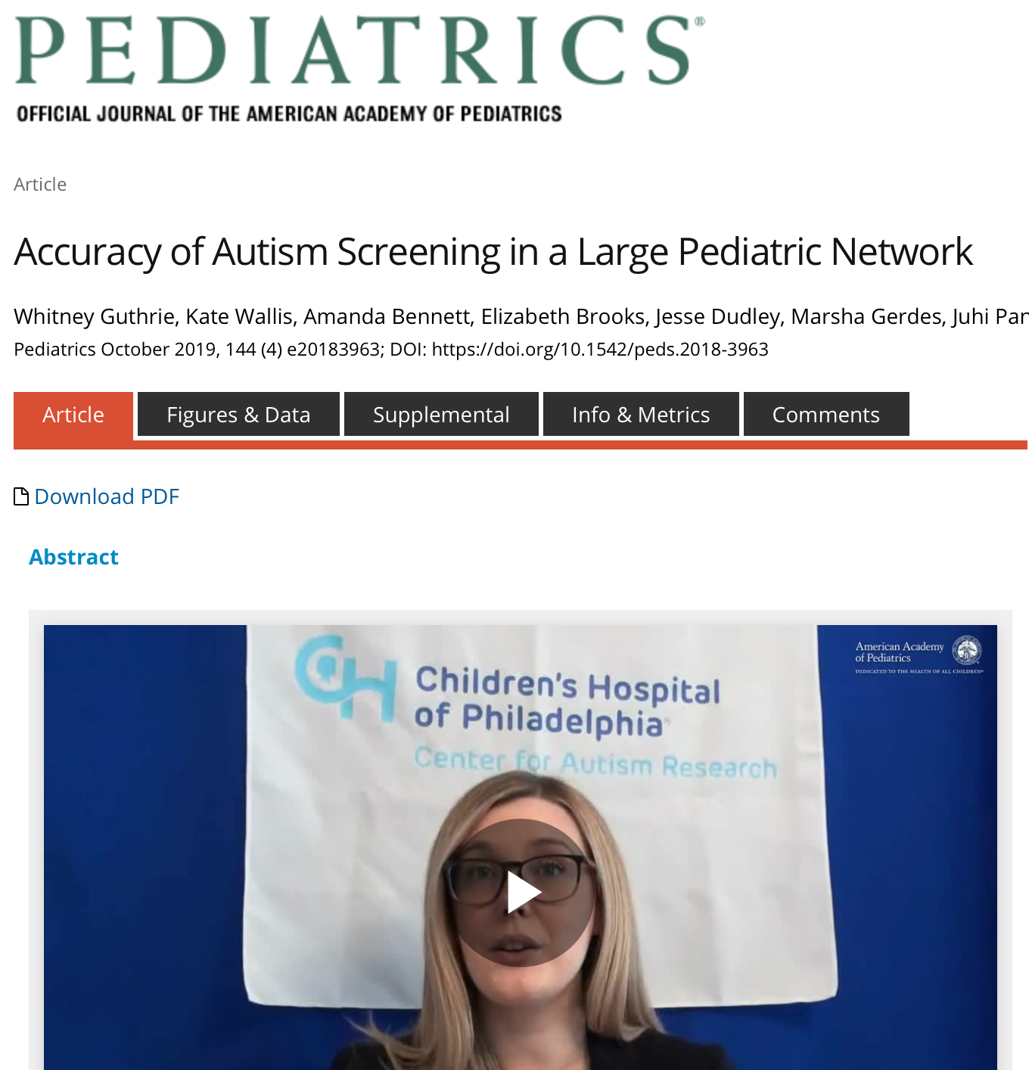
ASD Computable Phenotype: - 2 codes, or 1 from pediatric psych

Slide 24
Two Competing Approaches
Predict risk of diagnosis
Need gold standard diagnoses…
Evaluate computable phenotype against gold standard
maybe you can evaluate TPR. Good luck with the rest.
Predict risk of an ASD- or ADHD-related diagnosis code
If we’re building a screening tool, this is probably good enough
So far, appears to give us similar results

Slide 25
3. Figure out what we’re really predicting

Slide 26
Dx Timing vs Probability vs Risk
Diagnosis Timing
known disparities
we don’t care to replicate
Diagnosis Probability
probably closer to what we really care about
figure out who will be diagnosed and diagnose them earlier
Diagnosis Risk
e.g. Cox PH models
blends timing and probability
Autism
ADHD
Cumulative Diagnosis Rate
Age, in Years

Slide 27
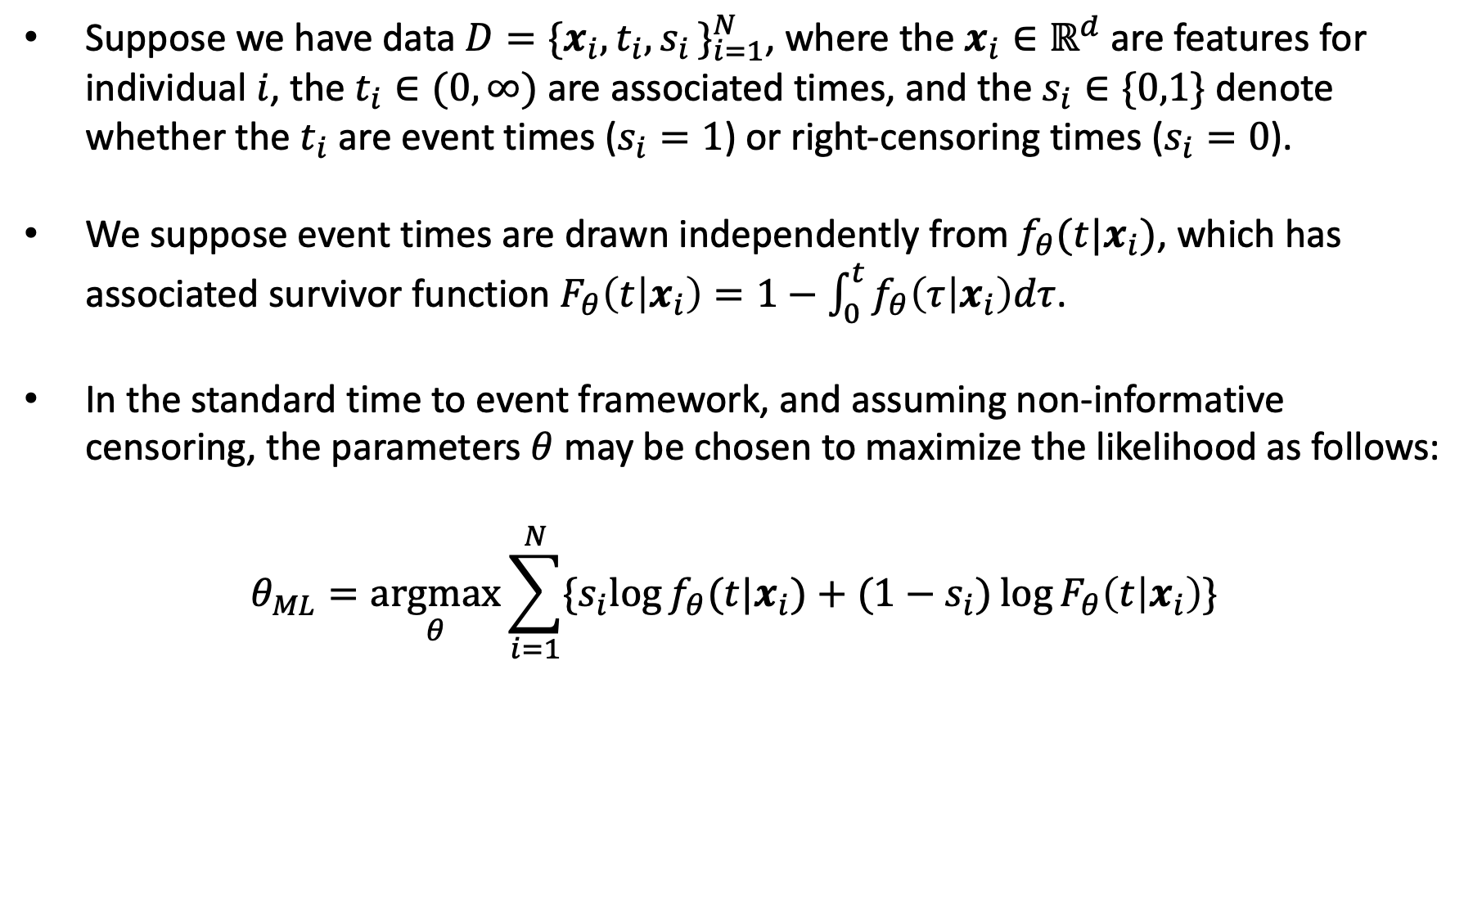
Standard time to event model: the right setup?
Suppose we have data $D=\{x_{i},t_{i}{,s}_{i}\}_{i=1}^{N}$, where the $x_{i}∈ℝ^{d}$ are features for individual $i$, the $t_{i}∈(0,∞)$ are associated times, and the $s_{i}∈\{0,1\}$ denote whether the $t_{i}$ are event times ($s_{i}=1$) or right-censoring times ($s_{i}=0$).
We suppose event times are drawn independently from $f_{θ}(t|x_{i})$, which has associated survivor function $F_{θ}\left(t | x_{i}\right)=1−\int_{0}^{t}{f_{θ}\left(τ | x_{i}\right)dτ}$.
In the standard time to event framework, and assuming non-informative censoring, the parameters $θ$ may be chosen to maximize the likelihood as follows:
$$θ_{ML}=\underset{θ}{argmax}{\sum_{i=1}^{N}{{\{s}_{i}\log{f_{θ}(t|x_{i})}+(1−s_{i})\log{F_{θ}\left(t | x_{i}\right)}\}}}$$
Notes:
But I do want to talk about some of the methodological work I’ve done that was motivated largely by this problem
Learning from censored observations, particularly right-censored observations, is critical here
We could treat this as a binary classification problem, but if we did that, we’d have to limit ourselves to individuals with adequate follow-up
And on top of the fact that we’d be losing a lot of good data, this is a really bad idea, because we know that many of the groups that are diagnosed less promptly also have less consistent follow-up
So we’d really be shooting ourselves in the foot if we ignore that data
But at the same time, what we really want IS a binary classifier -- we want to predict is whether diagnosis will occur, at some point
And we’re NOT interested in a prediction of diagnosis risk that replicates existing patterns of diagnosis timing –
For children whose diagnosis probability is high, we’d like to raise a flag to providers – in particular, primary care providers who don’t necessarily have detailed knowledge of autism or ADHD -- much earlier
So again, what we really want is a binary classifier – but one that learns from censored events
Can think of this as positive unlabeled learning – if you’ve been diagnosed, you’re a positive case…
If you haven’t been diagnosed, you’re not necessarily a negative case – you could still be diagnosed next week
So, it’s kind of like positive unlabeled learning, but with additional information about the probability of labeling derived from the censoring time
Because notice, the censoring time does provide information about the probability of diagnosis: if censoring happens late, very unlikely that diagnosis will happen subsequently, whereas if it happens early, the diagnosis can’t be ruled out
So again, what we’d really like is a model that predicts diagnosis probability that is distinct from diagnosis timing
But when you use the standard time to event setup, those two factors are conflated – the model supposes that events take place eventually, so that there’s no distinction between events unlikely to ever occur, and events that are highly likely to occur, but after a long delay
There are nuances to this – ways to get around this that are different from the one we’ve proposed -- for example, you can use a non-parametric estimator of the hazard rate
But this an important limitation, one that had been noticed by others in the past, in particular researchers who were still focused on survival, but wanted to predict the probability of long-term survival

Slide 28
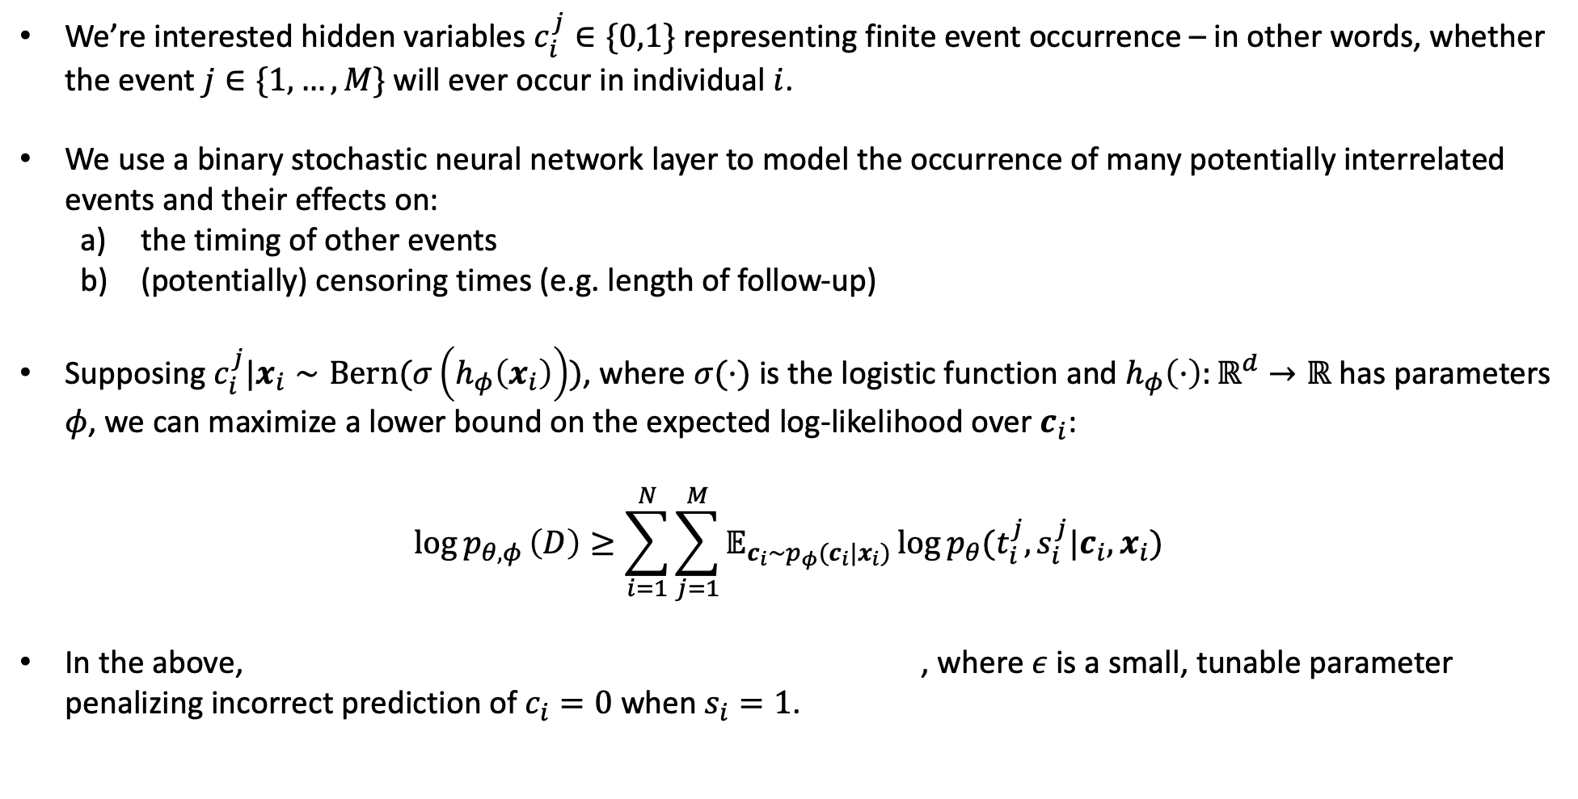
Neural Mixture Cure: Separate Probability from Timing
We’re interested hidden variables $c_{i}^{j}∈\{0,1\}$ representing finite event occurrence – in other words, whether the event $j∈\{1,…,M\}$ will ever occur in individual $i$.
We use a binary stochastic neural network layer to model the occurrence of many potentially interrelated events and their effects on:
the timing of other events
(potentially) censoring times (e.g. length of follow-up)
Supposing $c_{i}^{j}|x_{i}∼Bern(σ\left(h_{φ}\left(x_{i}\right)\right))$, where $σ(·)$ is the logistic function and $h_{φ}\left(·\right):ℝ^{d}→ℝ$ has parameters $φ$, we can maximize a lower bound on the expected log-likelihood over $c_{i}$:
$$\log{p_{θ,φ}}\left(D\right)≥\sum_{i=1}^{N}{\sum_{j=1}^{M}{𝔼_{c_{i}∼p_{φ}(c_{i}|x_{i})}\log{p_{θ}(t_{i}^{j},s_{i}^{j}|c_{i},x_{i})}}}$$
In the above, , where $ε$ is a small, tunable parameter penalizing incorrect prediction of $c_{i}=0$ when $s_{i}=1$.
Notes:
But I wanted to take a new approach, one that directly tackles this limitation by leveraging advances in (a) deep survival analysis,
-- lots of work recently showing that there is indeed benefit in having the hazard rate or event density parameterized with a deep neural network
-- and (b) recent work in gradient estimation methods for binary stochastic neural networks
The central idea is we can model finite event occurrence is a latent variable, instantiated as a binary stochastic neural network layer
So, binary stochastic layer, modeling the eventual occurrence, or lack thereof, of a large number of potentially interrelated events
Thinking about the neuron corresponding to a single event, there are two possibilities:
Case 1: event occurrence. In this case, the likelihood follows the standard time to event model
Case 2: no event occurrence. In this case, the likelihood is determined by the censoring density only
For the densities themselves, we use an accelerated failure time model with lognormal base density, that can be accelerated or decelerated by the effect of covariates, including – importantly – the occurrence of other events
You could also use a Cox-PH setup
And with this approach, we get exactly what we want – we get a model predicting the values of those latent variables for a given individual, a model that tells us the probability of eventual autism diagnosis, for instance, without that information being conflated with the likely timing of the diagnosis
And on top of that, the presence of one condition can effect the timing of others – for example, the presence of ADHD can effect the timing of autism diagnosis – by the way, there’s a known, real effect – children with co-occurring ADHD symptoms are diagnosed with autism much later – ADHD is said to “mask” the presence of autism
And vice-versa
And then even further, this gives us a straightforward way to relax our non-informative censoring assumption – these latent variables can affect the censoring density as well
But, of course, training is a little more challenging than the standard setup due to the presence of that stochastic binary layer – to backpropagate gradients across that layer – again, event occurrence is Bernoulli distributed -- we have to use a gradient estimator. For this work, we found that the Gumbel-Softmax estimator worked quite well even after trying more recently developed estimators like augment-reinforce-merge

Slide 29
Results: It works with fake data!
Figure: Prediction of event occurrence on two synthetic datasets. When no censoring is present, a binary classifier predicts event occurrence perfectly (left). When censoring is present, our model (middle left) predicts event occurrence more effectively than the standard event time model (middle right) and binary classifier (right).
Notes:
And what’s kind of amazing is that – for events that don’t always occur, and which are heavily right-censored – for tasks like diagnosis prediction -- much better prediction performance falls right out of this setup
Here’s an illustration of our results on synthetic data.
Can think of the left panel as an oracle method:
This is a binary classifier that, during training, can see past censoring – it sees whether events occur, whereas the other models only see whether events are observed under censoring
And so we have blue points – in the top panels, these are individuals that won’t develop autism, let’s say, and in the bottom panels they’re individuals who won’t develop ADHD
And orange points are individuals who will
Since censoring is removed for the oracle, it’s not surprising that it’s able to distinguish two groups perfectly
But when censoring enters the picture, things get more difficult
Important to note is that while event occurrence is affected only by the covariates visualized here, event timing is affected by additional covariates not pictured
Now, looking at the right panels first, we can see what happens when we train a simple binary classifier to distinguish between cases where the event was observed versus not observed
Not surprisingly, it does a poor job predicting event occurrence, because it’s not taking advantage of additional information provided by the censoring times
But even more interesting is the standard time to event setup, shown in the middle right panels
As I’ve described before, these models are conflating the probability of event occurrence with its likely timing, and as a result, its predictions are a very poor surrogate for the probability of event occurrence
But our model, shown in the middle left panels, does an excellent job recovering those probabilities despite learning from censored observations

Slide 30
Results: It works with real data!!!
Figure: AUC (left) and mean relative absolute error (right) for all prediction tasks.
Notes:
But what about when we moved beyond synthetic, and arguably contrived, data?
We looked at predicting a range of clinically relevant events from MIMIC-III, events that don’t occur in the first 24 hours, based on measurements taken within that first 24 hours
We also looked at Reddit – for those who aren’t familiar, this is a website where people post interesting content and then lots more people comment on it – you might think of this as Twitter on a research budget, because it turns out getting a huge number of Tweets would have burned right through my research budget and sent me into debt for the rest of my life
But the goal was to predict, based on a given user’s first 20 comments to the site, whether they’d later post to specific communities on Reddit related to mental health – there’s a community for helping individuals with depression, for ADHD support, even one called SuicideWatch
And in both cases, we found that our model not only made better predictions about whether they’d post to those communities, but also made better predictions about when they’d do it
The results don’t quite beat you over the head like they do with the synthetic data designed specifically to illustrate the need for this approach
But they are better

Slide 31
4. An impenetrable wall of text

Slide 32
negative notes
(i.e. decreased risk)
positive notes
(i.e. increased risk)

Slide 33
COMPLETELY IRRELEVANT NOTES
negative notes
(i.e. decreased risk)
positive notes
(i.e. increased risk)

Slide 34
COMPLETELY IRRELEVANT NOTES
Predict on a note level or patient level?
Conceptual differences
Computational challenges
Find a way to remove irrelevant notes
negative notes
(i.e. decreased risk)
positive notes
(i.e. increased risk)

Slide 35
COMPLETELY IRRELEVANT NOTES
Bonus challenge:
Because we are looking at early risk factors, providers can’t necessarily tell us which notes belong in which bucket
negative notes
(i.e. decreased risk)
positive notes
(i.e. increased risk)

Slide 36
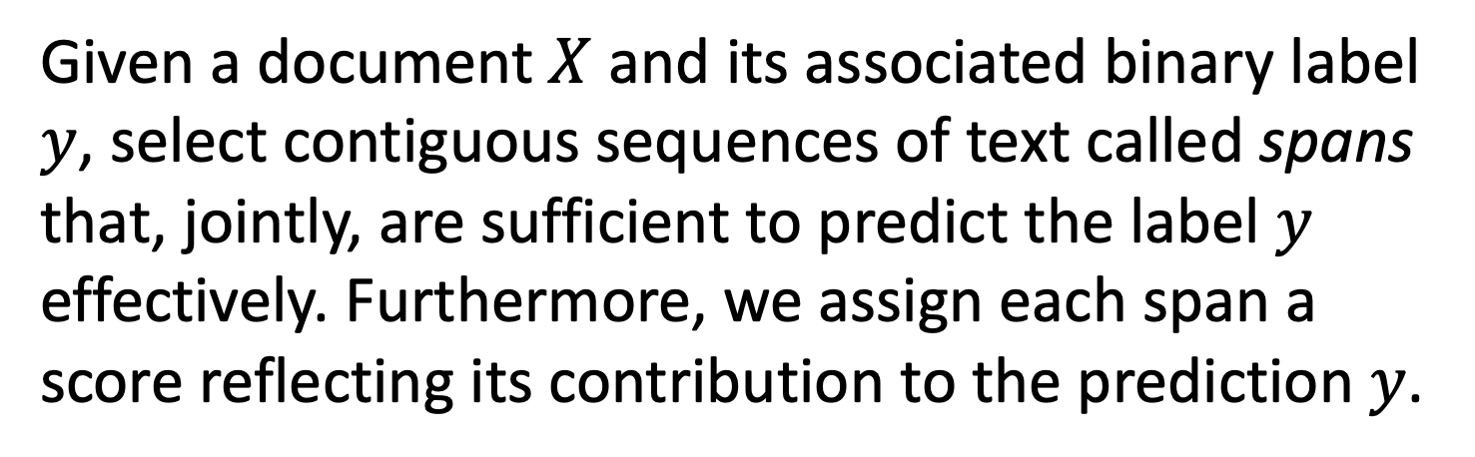
Predictive Extraction: Identifying predictive content within (clinical) text
Given a document $X$ and its associated binary label $y$, select contiguous sequences of text called spans that, jointly, are sufficient to predict the label $y$ effectively. Furthermore, we assign each span a score reflecting its contribution to the prediction $y$.
Notes:
Last but not least, I want to talk about an example that gets back to this idea that deep collaboration is bidirectional – we’ve developed models that, I think it’s fair to say, are influencing the way we’re thinking about autism
This is work done in close collaboration with Vivek Subramanian in ECE, and Sam Berchuck in statistical sciences
Now, in our work to predict autism and ADHD, we’re not just looking at structured data – we’re looking at clinical notes as well
But on top of using that info to make better predictions, we’d also like to have a model that tells us what it is, specifically, within the clinical notes, that is predictive
There are at least two reasons why this is important
The first is that the clinicians – and we -- would like to verify that the model isn’t doing something it shouldn’t be
But the second is that this potentially gives us a way to identify descriptive risk factors – risk factors that can’t be encapsulated as a single word, and wouldn’t be found as a structured data element – potentially risk factors that are currently unknown
We’re calling this task predictive extraction – the idea is to identify contiguous sequences of text -- ”spans” of text – that, taken together, are sufficient to predict the label effectively
This has sometimes been called rationale learning
Now, there’s an extensive literature on extractive summarization – selecting spans of text that adequately summarize a given document – but in that case, the training data are annotated to indicate which spans constitute a good summary. In contrast, we’re trying to identify predictive spans based on the labels alone

Slide 37
Our Predictive Extraction Architecture
Subramanian V, Engelhard MM, Berchuck SI, Henao R, Chen L, Carin L. SpanPredict: Extraction of Predictive Document Spans with Neural Attention. Submitted to 16th conference of the European Chapter of the Association for Computational Linguistics (EACL).
Notes:
And we’ve developed a model that does this quite effectively
We begin with token embeddings, which are then contextualized with a convolutional layer
Alternatively, but we could use e.g. BERT embeddings
And then, we’ve created a way to construct these spans, which are passed to subsequent layers of the model, without doing anything that’s not differentiable. And as a result, it’s straightforward to train this model end to end with stochastic gradient descent
Details:
1 – we apply a linear attention mechanism to the contextualized tokens, which gives us distributions over those tokens that tell us which ones are most and least promising as start and end positions.
2 – we take a cumulative sum over those distributions – for the start positions, it’s a cumulative sum from the left, and for the end positions, it’s a cumulative sum from the right – you can think of this, loosely speaking, as specifying the probability that a given token is after the start of the span and before the end of the span, respectively
3 – and by multiplying these two cumulative sums together, we have weights that tell us how much each token should contribute to the span
4 – applying these weights to the tokens gives us a representation for the span, and subsequent steps are straightforward – we use max pooling to condense each span to a single vector, and a final linear layer predicts the contribution of that span to the log-odds of a positive label

Slide 38
Example Span Selection
Subramanian V, Engelhard MM, Berchuck SI, Henao R, Chen L, Carin L. SpanPredict: Extraction of Predictive Document Spans with Neural Attention. Submitted to 16th conference of the European Chapter of the Association for Computational Linguistics (EACL).

Slide 39
Control span size by penalizing overlap via JS divergence
Subramanian V, Engelhard MM, Berchuck SI, Henao R, Chen L, Carin L. SpanPredict: Extraction of Predictive Document Spans with Neural Attention. Submitted to 16th conference of the European Chapter of the Association for Computational Linguistics (EACL).

Slide 40
Non-medical text: high agreement with humans
Subramanian V, Engelhard MM, Berchuck SI, Henao R, Chen L, Carin L. SpanPredict: Extraction of Predictive Document Spans with Neural Attention. Submitted to 16th conference of the European Chapter of the Association for Computational Linguistics (EACL).

Slide 41
Clinical notes: partial agreement with clinicians
Subramanian V, Engelhard MM, Berchuck SI, Henao R, Chen L, Carin L. SpanPredict: Extraction of Predictive Document Spans with Neural Attention. Submitted to 16th conference of the European Chapter of the Association for Computational Linguistics (EACL).
Notes:
These clinical phenotypes are way more complex than people judging a movie – not surprising that we don’t see the same level of agreement
Do they tell us

Slide 42
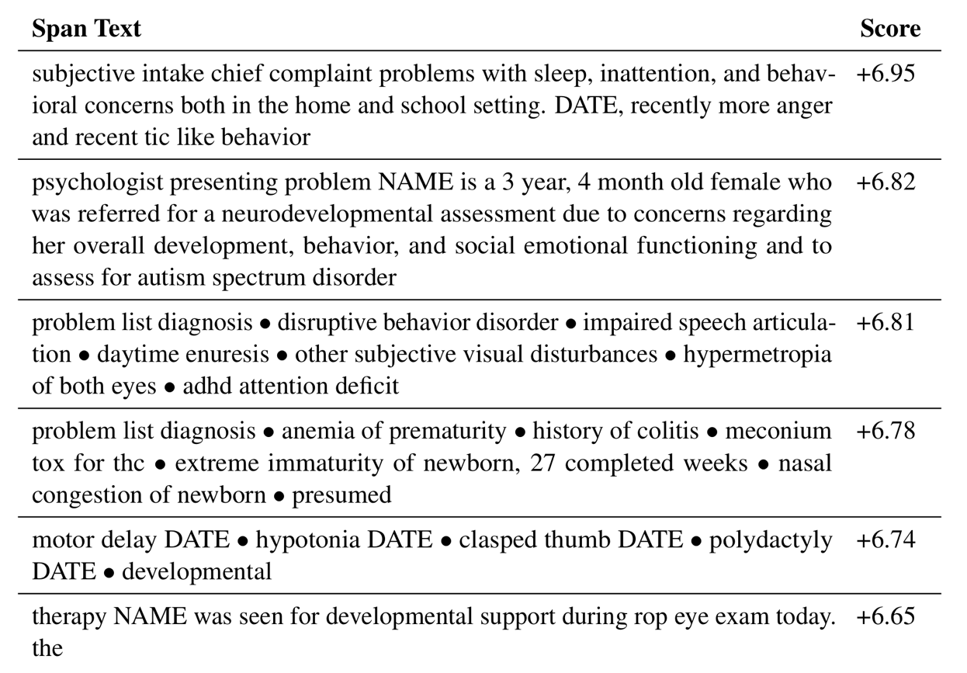
Passages most predictive of autism diagnosis
Passage (from note) | Change in predicted dx log-odds
Developmental and behavioral concerns are highly predictive
Premature birth and perinatal complications are also highly predictive
Subramanian V, Engelhard MM, Berchuck SI, Henao R, Chen L, Carin L. SpanPredict: Extraction of Predictive Document Spans with Neural Attention. Submitted to 16th conference of the European Chapter of the Association for Computational Linguistics (EACL).
Duke Forge, NICHD 1P50HD093074, NIMH/NINDS 1 R01 MH121329
Notes:
Bidirectionality: we want models that are informed by clinical judgement, but it’s also possible that they can inform practice
How do we build better data systems, better EHRs, that lend themselves to this kind of research
Need new modeling techniques to deal with this data – this is where my value is
Make sure I highlight (1) I’ve been trained as a physician, and all this work comes from being immersed in a clinical environment, and (2) model selection is informed by that clinical experience
Problems I’m approaching – short step to get it to be meaningful clinically
Developing new techniques that are clinically motivated – toward impact

Slide 43
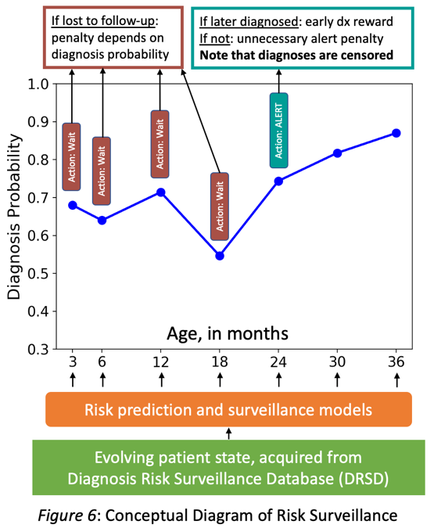
Next steps: new methods, evidence for impact
Prediction of retinopathy of prematurity in Pediatrix cohort
Prediction of surgery risk
Silent deployment of autism and ADHD prediction in Duke EHR (K01 proposal)
Notes:
First and foremost, we want these models to actually get to clinicians! So, I’ve proposed a silent deployment, it’d be in collaboration with DIHI who have quite a track record in this area, where we’d integrate our models in the Duke EHR and start to prospectively evaluate them.
A big part of that proposal – this is a K01 career development award…
And further, we have several collaborations…

Slide 44
Thank you!
Contact: m.engelhard@duke.edu
Notes:
Thanks again – with that, I want to open it up for questions

